Slide 1
Module #1:
The Fundamentals of Logic (1)
26年 11月 8日
© 2001-2004 Michael P. Frank, revised by S. Kang
Notes:
Discrete Math - Module #1 - Logic
26年 11月 8日
(c)2001-2002, Michael P. Frank

Slide 2
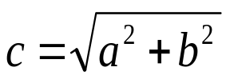
Module #1: Foundations of Logic
(§§1.1-1.3)
Mathematical Logic is a tool for working with elaborate compound statements. It includes:
A formal language for expressing them.
A concise notation for writing them.
A methodology for objectively
reasoning about their truth or falsity.
It is the foundation for expressing
formal proofs in all branches of mathematics.
b
a
26年 11月 8日
© 2001-2004 Michael P. Frank, revised by S. Kang
Notes:
Discrete Math - Module #1 - Logic
26年 11月 8日
(c)2001-2002, Michael P. Frank

Slide 3
Foundations of Logic: Overview
Propositional logic (§1.1-1.2):
  Basic definitions. (§1.1)
  Equivalence rules & derivations. (§1.2)
Predicate logic (§1.3-1.4)
  Predicates.
  Quantified predicate expressions.
  Equivalences & derivations.
26年 11月 8日
© 2001-2004 Michael P. Frank, revised by S. Kang
Notes:
Discrete Math - Module #1 - Logic
26年 11月 8日
(c)2001-2002, Michael P. Frank

Slide 4
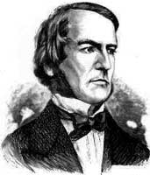
Propositional Logic (§1.1)
Topic #1 – Propositional Logic
Propositional Logic is the logic of compound statements built from simpler statements
using so-called Boolean connectives.
Some applications in computer science:
Design of digital electronic circuits.
Expressing conditions in programs.
Queries to databases & search engines.
George Boole
(1815-1864)
26年 11月 8日
© 2001-2004 Michael P. Frank, revised by S. Kang
Notes:
Discrete Math - Module #1 - Logic
26年 11月 8日
(c)2001-2002, Michael P. Frank

Slide 5
Definition of a Proposition
Topic #1 – Propositional Logic
Definition: A proposition (denoted p, q, r, …) is simply:
a statement (i.e., a declarative sentence)
  with some definite meaning, (not vague or ambiguous)
having a truth value that’s either true (T) or false (F)
  it is never both, neither, or somewhere “in between!”
    However, you might not know the actual truth value,
    and, the truth value might depend on the situation or context.
Later, we will study probability theory, in which we assign degrees of certainty (“between” T and F) to propositions.
  But for now: think True/False only!
26年 11月 8日
© 2001-2004 Michael P. Frank, revised by S. Kang
Notes:
Discrete Math - Module #1 - Logic
26年 11月 8日
(c)2001-2002, Michael P. Frank

Slide 6
Examples of Propositions
Topic #1 – Propositional Logic
“It is raining.” (In a given situation.)
“Seoul is the capital of Korea.” • “1 + 2 = 3”
But, the following are NOT propositions:
“Who’s there?” (interrogative, question)
“La la la la la.” (meaningless interjection)
“Just do it!” (imperative, command)
“Yeah, I sorta dunno, whatever...” (vague)
“1 + 2” (expression with a non-true/false value)
26年 11月 8日
© 2001-2004 Michael P. Frank, revised by S. Kang
Notes:
Discrete Math - Module #1 - Logic
26年 11月 8日
(c)2001-2002, Michael P. Frank

Slide 7
Operators / Connectives
Topic #1.0 – Propositional Logic: Operators
An operator or connective combines one or more operand expressions into a larger expression. (E.g., “+” in numeric exprs.)
Unary operators take 1 operand (e.g., −3); binary operators take 2 operands (eg 3 × 4).
Propositional or Boolean operators operate on propositions (or their truth values) instead of on numbers.
26年 11月 8日
© 2001-2004 Michael P. Frank, revised by S. Kang
Notes:
Discrete Math - Module #1 - Logic
26年 11月 8日
(c)2001-2002, Michael P. Frank

Slide 8
Some Popular Boolean Operators
Topic #1.0 – Propositional Logic: Operators
Formal Name | Nickname | Arity | Symbol
Negation operator | NOT | Unary | ¬
Conjunction operator | AND | Binary | ∧
Disjunction operator | OR | Binary | ∨
Exclusive-OR operator | XOR | Binary | ⊕
Implication operator | IMPLIES | Binary | →
Biconditional operator | IFF | Binary | ↔
26年 11月 8日
© 2001-2004 Michael P. Frank, revised by S. Kang
Notes:
Discrete Math - Module #1 - Logic
26年 11月 8日
(c)2001-2002, Michael P. Frank

Slide 9
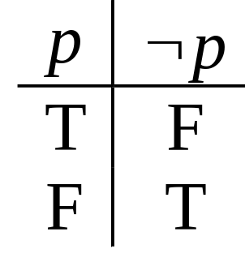
The Negation Operator
Topic #1.0 – Propositional Logic: Operators
The unary negation operator “¬” (NOT) transforms a prop. into its logical negation.
E.g. If p = “I have brown hair.”
then ¬p = “I do not have brown hair.”
The truth table for NOT:
T :≡ True; F :≡ False
“:≡” means “is defined as”
Operand
column
Result
column
26年 11月 8日
© 2001-2004 Michael P. Frank, revised by S. Kang
Notes:
Discrete Math - Module #1 - Logic
26年 11月 8日
(c)2001-2002, Michael P. Frank

Slide 10
The Conjunction Operator
Topic #1.0 – Propositional Logic: Operators
The binary conjunction operator “∧” (AND) combines two propositions to form their logical conjunction.
E.g. If p=“I will have salad for lunch.” and q=“I will have steak for dinner.”, then p∧q=“I will have salad for lunch and
I will have steak for dinner.”
26年 11月 8日
© 2001-2004 Michael P. Frank, revised by S. Kang
Notes:
Discrete Math - Module #1 - Logic
26年 11月 8日
(c)2001-2002, Michael P. Frank

Slide 11
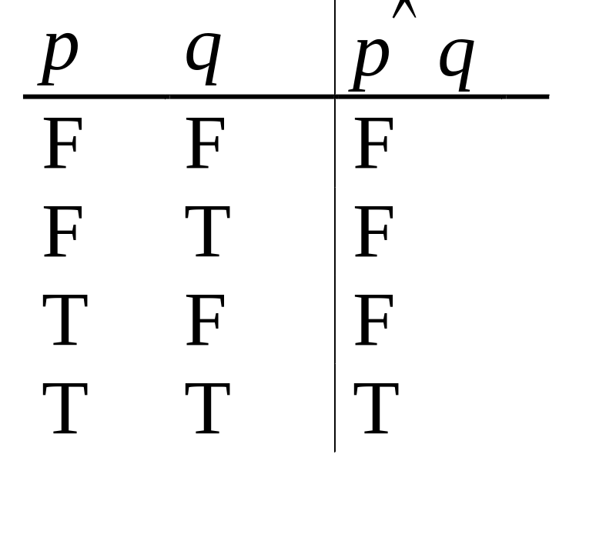
Conjunction Truth Table
Topic #1.0 – Propositional Logic: Operators
Operand columns
Note that a
conjunction
p₁ ∧ p₂ ∧ … ∧ p_{n}
of n propositions
will have 2^{n} rows
in its truth table.
Also: ¬ and ∧ operations together are suffi-cient to express any Boolean truth table!
26年 11月 8日
© 2001-2004 Michael P. Frank, revised by S. Kang
Notes:
Discrete Math - Module #1 - Logic
26年 11月 8日
(c)2001-2002, Michael P. Frank

Slide 12
The Disjunction Operator
Topic #1.0 – Propositional Logic: Operators
The binary disjunction operator “∨” (OR) combines two propositions to form their logical disjunction.
p=“My car has a bad engine.”
q=“My car has a bad carburetor.”
p∨q=“Either my car has a bad engine, or
my car has a bad carburetor.”
Meaning is like “and/or” in English.
26年 11月 8日
© 2001-2004 Michael P. Frank, revised by S. Kang
Notes:
Discrete Math - Module #1 - Logic
26年 11月 8日
(c)2001-2002, Michael P. Frank

Slide 13
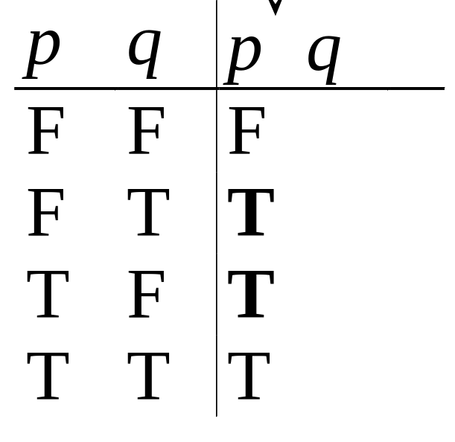
Disjunction Truth Table
Topic #1.0 – Propositional Logic: Operators
Note that p∨q means
that p is true, or q is
true, or both are true!
So, this operation is
also called inclusive or,
because it includes the
possibility that both p and q are true.
“¬” and “∨” together are also universal.
Note
difference
from AND
26年 11月 8日
© 2001-2004 Michael P. Frank, revised by S. Kang
Notes:
Discrete Math - Module #1 - Logic
26年 11月 8日
(c)2001-2002, Michael P. Frank

Slide 14
Nested Propositional Expressions
Topic #1.0 – Propositional Logic: Operators
Use parentheses to group sub-expressions:
“I just saw my old friend, and either he’s grown or I’ve shrunk.” = f ∧ (g ∨ s)
  (f ∧ g) ∨ s would mean something different
  f ∧ g ∨ s would be ambiguous
By convention, “¬” takes precedence over both “∧” and “∨”.
  ¬s ∧ f means (¬s) ∧ f , not ¬ (s ∧ f)
26年 11月 8日
© 2001-2004 Michael P. Frank, revised by S. Kang
Notes:
Discrete Math - Module #1 - Logic
26年 11月 8日
(c)2001-2002, Michael P. Frank

Slide 15
A Simple Exercise
Topic #1.0 – Propositional Logic: Operators
Let p=“It rained last night”,
q=“The sprinklers came on last night,”
r=“The lawn was wet this morning.”
Translate each of the following into English:
¬p =
r ∧ ¬p =
¬ r ∨ p ∨ q =
“It didn’t rain last night.”
“The lawn was wet this morning, and
it didn’t rain last night.”
“Either the lawn wasn’t wet this morning, or it rained last night, or the sprinklers came on last night.”
26年 11月 8日
© 2001-2004 Michael P. Frank, revised by S. Kang
Notes:
Discrete Math - Module #1 - Logic
26年 11月 8日
(c)2001-2002, Michael P. Frank

Slide 16
The Exclusive Or Operator
Topic #1.0 – Propositional Logic: Operators
The binary exclusive-or operator “⊕” (XOR) combines two propositions to form their logical “exclusive or”.
p = “I will earn an A in this course,”
q = “I will drop this course,”
p ⊕ q = “I will either earn an A in this course, or I will drop it (but not both!)”
26年 11月 8日
© 2001-2004 Michael P. Frank, revised by S. Kang
Notes:
Discrete Math - Module #1 - Logic
26年 11月 8日
(c)2001-2002, Michael P. Frank

Slide 17
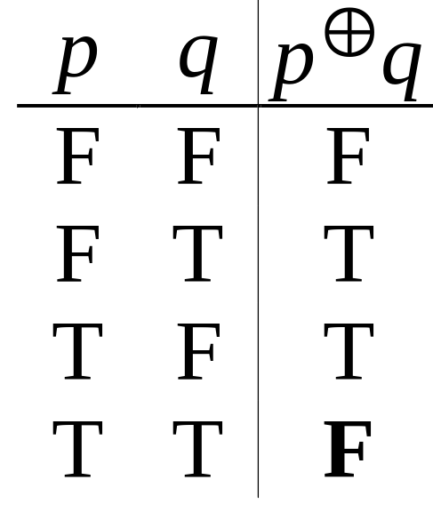
Exclusive-Or Truth Table
Topic #1.0 – Propositional Logic: Operators
Note that p⊕q means
that p is true, or q is
true, but not both!
This operation is
called exclusive or,
because it excludes the
possibility that both p and q are true.
“¬” and “⊕” together are not universal.
Note
difference
from OR.
26年 11月 8日
© 2001-2004 Michael P. Frank, revised by S. Kang
Notes:
Discrete Math - Module #1 - Logic
26年 11月 8日
(c)2001-2002, Michael P. Frank

Slide 18
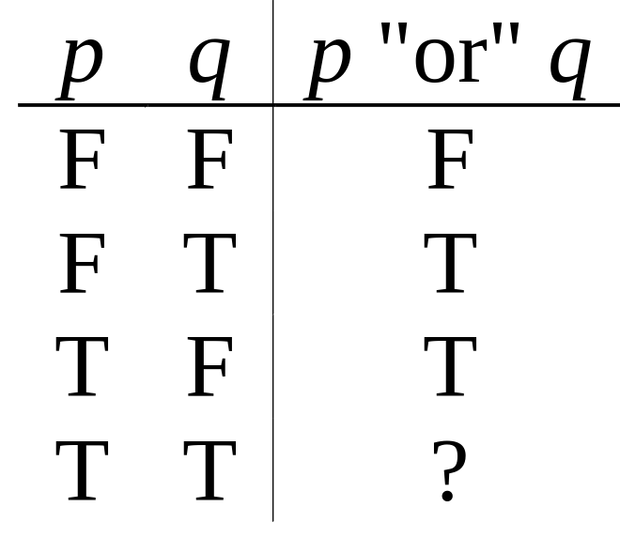
Natural Language is Ambiguous
Topic #1.0 – Propositional Logic: Operators
Note that English “or” can be ambiguous regarding the “both” case!
“Pat is a singer or
Pat is a writer.” -
“Pat is a man or
Pat is a woman.” -
Need context to disambiguate the meaning!
For this class, assume “or” means inclusive.
∨
⊕
26年 11月 8日
© 2001-2004 Michael P. Frank, revised by S. Kang
Notes:
Discrete Math - Module #1 - Logic
26年 11月 8日
(c)2001-2002, Michael P. Frank

Slide 19
The Implication Operator
Topic #1.0 – Propositional Logic: Operators
antecedent
consequent
The implication p → q states that p implies q.
I.e., If p is true, then q is true; but if p is not true, then q could be either true or false.
E.g., let p = “You study hard.”
q = “You will get a good grade.”
p → q = “If you study hard, then you will get a good grade.” (else, it could go either way)
26年 11月 8日
© 2001-2004 Michael P. Frank, revised by S. Kang
Notes:
Discrete Math - Module #1 - Logic
26年 11月 8日
(c)2001-2002, Michael P. Frank

Slide 20
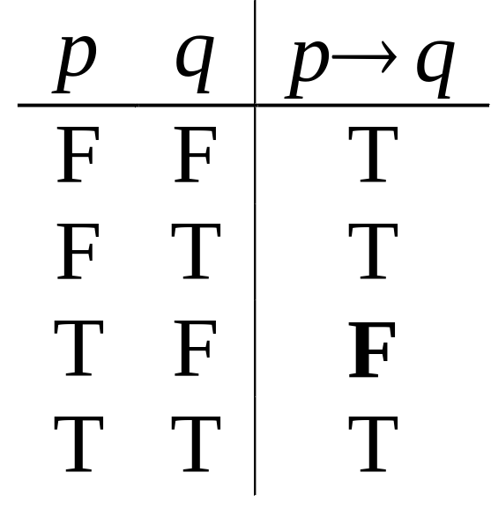
Implication Truth Table
Topic #1.0 – Propositional Logic: Operators
p → q is false only when
p is true but q is not true.
p → q does not say
that p causes q!
p → q does not require
that p or q are ever true!
E.g. “(1=0) → pigs can fly” is TRUE!
The
only
False
case!
26年 11月 8日
© 2001-2004 Michael P. Frank, revised by S. Kang
Notes:
Discrete Math - Module #1 - Logic
26年 11月 8日
(c)2001-2002, Michael P. Frank

Slide 21
Examples of Implications
Topic #1.0 – Propositional Logic: Operators
“If this lecture ever ends, then the sun will rise tomorrow.” True or False?
“If Tuesday is a day of the week, then I am a penguin.” True or False?
“If 1+1=6, then PGH is president.”
True or False?
“If the moon is made of green cheese, then I am richer than Bill Gates.” True or False?
26年 11月 8日
© 2001-2004 Michael P. Frank, revised by S. Kang
Notes:
Discrete Math - Module #1 - Logic
26年 11月 8日
(c)2001-2002, Michael P. Frank

Slide 22
Why does this seem wrong?
Consider a sentence like,
  “If I wear a red shirt tomorrow, then CSE professors will give A+ to all students!”
In logic, we consider the sentence True so long as either I don’t wear a red shirt, or professors give A+ to all students.
But, in normal English conversation, if I were to make this claim, you would think that I was lying.
26年 11月 8日
© 2001-2004 Michael P. Frank, revised by S. Kang
Notes:
Discrete Math - Module #1 - Logic
26年 11月 8日
(c)2001-2002, Michael P. Frank

Slide 23
Resolving the Discrepancy
In English, a sentence “if p then q” usually really implicitly means something like,
  “In all possible situations, if p then q.”
    That is, “For p to be true and q false is impossible.”
    Or, “I guarantee that no matter what, if p, then q.”
This can be expressed in predicate logic as:
  “For all situations s, if p is true in situation s, then q is also true in situation s”
  Formally, we could write: ∀s, P(s) → Q(s)
That sentence is logically False in our example, because for me to wear a red shirt and for professors not to give A+ is a possible situation.
  Natural language and logic then agree with each other.
26年 11月 8日
© 2001-2004 Michael P. Frank, revised by S. Kang
Notes:
Discrete Math - Module #1 - Logic
26年 11月 8日
(c)2001-2002, Michael P. Frank

Slide 24
Converse, Inverse, Contrapositive
Topic #1.0 – Propositional Logic: Operators
Some terminology, for an implication p → q:
Its converse (역명제) is: q → p.
Its inverse (이명제) is: ¬p → ¬q.
Its contrapositive (대우명제) : ¬q → ¬ p.
One of these three has the same meaning (same truth table) as p → q. Can you figure out which?
Contrapositive
26年 11月 8日
© 2001-2004 Michael P. Frank, revised by S. Kang
Notes:
Discrete Math - Module #1 - Logic
26年 11月 8日
(c)2001-2002, Michael P. Frank

Slide 25
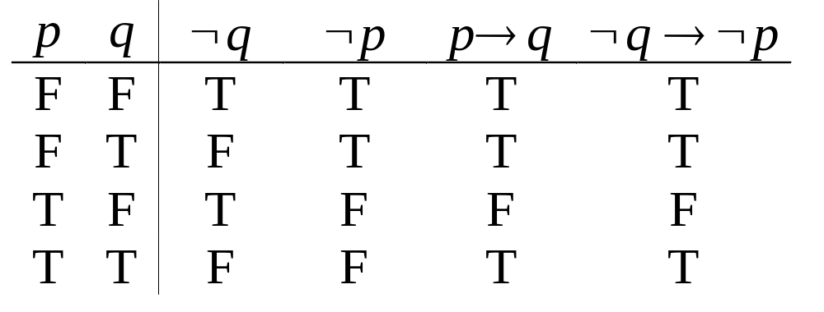
How do we know for sure?
Topic #1.0 – Propositional Logic: Operators
Proving the equivalence of p → q and its contrapositive using truth tables:
26年 11月 8日
© 2001-2004 Michael P. Frank, revised by S. Kang
Notes:
Discrete Math - Module #1 - Logic
26年 11月 8日
(c)2001-2002, Michael P. Frank

Slide 26
The biconditional operator
Topic #1.0 – Propositional Logic: Operators
The biconditional p ↔ q states that p is true if and only if (IFF) q is true.
p = “Tom is Richard’s son.”
q = “Richard is Tom’s father.”
p ↔ q = “If, and only if, Tom is Richard’s son, Richard is Tom’s father.”
26年 11月 8日
© 2001-2004 Michael P. Frank, revised by S. Kang
Notes:
Discrete Math - Module #1 - Logic
26年 11月 8日
(c)2001-2002, Michael P. Frank

Slide 27
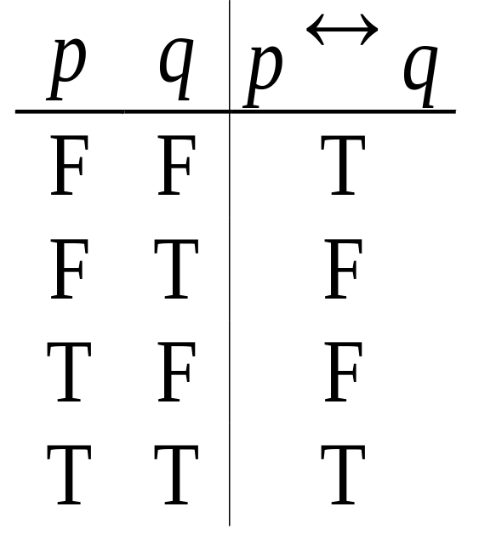
Biconditional Truth Table
Topic #1.0 – Propositional Logic: Operators
p ↔ q means that p and q
have the same truth value.
Note this truth table is the
exact opposite of ⊕’s!
  Thus, p ↔ q means ¬(p ⊕ q)
p ↔ q does not imply
that p and q are true, or that either of them causes the other, or that they have a common cause.
26年 11月 8日
© 2001-2004 Michael P. Frank, revised by S. Kang
Notes:
Discrete Math - Module #1 - Logic
26年 11月 8日
(c)2001-2002, Michael P. Frank

Slide 28
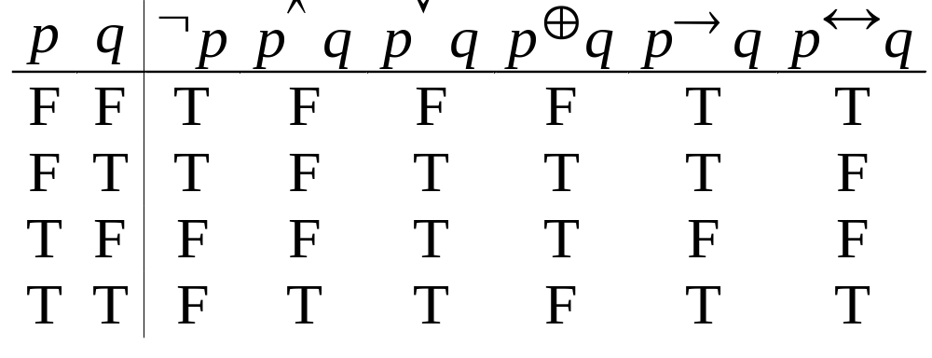
Boolean Operations Summary
Topic #1.0 – Propositional Logic: Operators
We have seen 1 unary operator and 5 binary operators. Their truth tables are below.
26年 11月 8日
© 2001-2004 Michael P. Frank, revised by S. Kang
Notes:
Discrete Math - Module #1 - Logic
26年 11月 8日
(c)2001-2002, Michael P. Frank

Slide 29
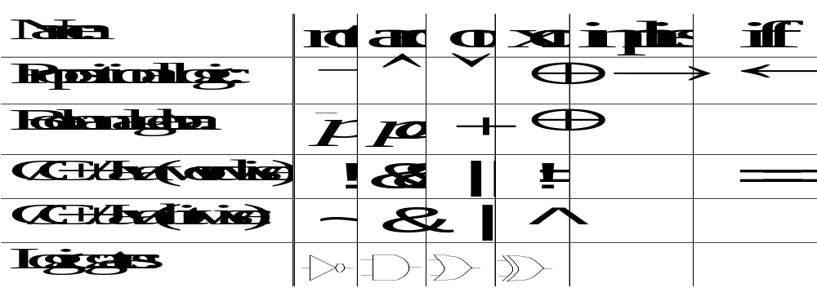
Some Alternative Notations
Topic #1.0 – Propositional Logic: Operators
26年 11月 8日
© 2001-2004 Michael P. Frank, revised by S. Kang
Notes:
Discrete Math - Module #1 - Logic
26年 11月 8日
(c)2001-2002, Michael P. Frank

Slide 30
Bits and Bit Operations
Topic #2 – Bits
A bit is a binary (base 2) digit: 0 or 1.
Bits may be used to represent truth values.
By convention:
0 represents “false”; 1 represents “true”.
Boolean algebra is like ordinary algebra except that variables stand for bits, + means “or”, and multiplication means “and”.
  See chapter 10 for more details.
26年 11月 8日
© 2001-2004 Michael P. Frank, revised by S. Kang
Notes:
Discrete Math - Module #1 - Logic
26年 11月 8日
(c)2001-2002, Michael P. Frank

Slide 31
Bit Strings
Topic #2 – Bits
A Bit string of length n is an ordered sequence (series) of n≥0 bits.
  More on sequences in §3.2.
By convention, bit strings are (sometimes) written left to right:
  e.g. the “first” bit of the bit string “1001101010” is 1.
  Watch out! Another common convention is that the rightmost bit is bit #0, the 2nd-rightmost is bit #1, etc.
When a bit string represents a base-2 number, by convention, the first (leftmost) bit is the most significant bit. Ex. 1101₂=8+4+1=13.
26年 11月 8日
© 2001-2004 Michael P. Frank, revised by S. Kang
Notes:
Discrete Math - Module #1 - Logic
26年 11月 8日
(c)2001-2002, Michael P. Frank

Slide 32
Counting in Binary
Topic #2 – Bits
Did you know that you can count to 1,023 just using two hands?
  How? Count in binary!
    Each finger (up/down) represents 1 bit.
To increment: Flip the rightmost (low-order) bit.
  If it changes 1→0, then also flip the next bit to the left,
    If that bit changes 1→0, then flip the next one, etc.
0000000000, 0000000001, 0000000010, …
…, 1111111101, 1111111110, 1111111111
26年 11月 8日
© 2001-2004 Michael P. Frank, revised by S. Kang
Notes:
Discrete Math - Module #1 - Logic
26年 11月 8日
(c)2001-2002, Michael P. Frank

Slide 33
Bitwise Operations
Topic #2 – Bits
Boolean operations can be extended to operate on bit strings as well as single bits.
E.g.:
01 1011 0110
11 0001 1101
11 1011 1111 Bit-wise OR
01 0001 0100 Bit-wise AND
10 1010 1011 Bit-wise XOR
26年 11月 8日
© 2001-2004 Michael P. Frank, revised by S. Kang
Notes:
Discrete Math - Module #1 - Logic
26年 11月 8日
(c)2001-2002, Michael P. Frank

Slide 34
Propositional Equivalence (§1.2)
Topic #1.1 – Propositional Logic: Equivalences
Two syntactically (i.e., textually) different compound propositions may be the semantically identical (i.e., have the same meaning). We call them equivalent. Learn:
Various equivalence rules or laws.
How to prove equivalences using symbolic derivations.
26年 11月 8日
© 2001-2004 Michael P. Frank, revised by S. Kang
Notes:
Discrete Math - Module #1 - Logic
26年 11月 8日
(c)2001-2002, Michael P. Frank

Slide 35
Tautologies and Contradictions
Topic #1.1 – Propositional Logic: Equivalences
A tautology is a compound proposition that is true no matter what the truth values of its atomic propositions are!
Ex. p ∨ ¬p [What is its truth table?]
A contradiction is a compound proposition that is false no matter what! Ex. p ∧ ¬p [Truth table?]
Other compound props. are contingencies.
26年 11月 8日
© 2001-2004 Michael P. Frank, revised by S. Kang
Notes:
Discrete Math - Module #1 - Logic
26年 11月 8日
(c)2001-2002, Michael P. Frank

Slide 36
Logical Equivalence
Topic #1.1 – Propositional Logic: Equivalences
Compound proposition p is logically equivalent to compound proposition q, written p⇔q, IFF the compound proposition p↔q is a tautology.
Compound propositions p and q are logically equivalent to each other IFF p and q contain the same truth values as each other in all rows of their truth tables.
26年 11月 8日
© 2001-2004 Michael P. Frank, revised by S. Kang
Notes:
Discrete Math - Module #1 - Logic
26年 11月 8日
(c)2001-2002, Michael P. Frank

Slide 37
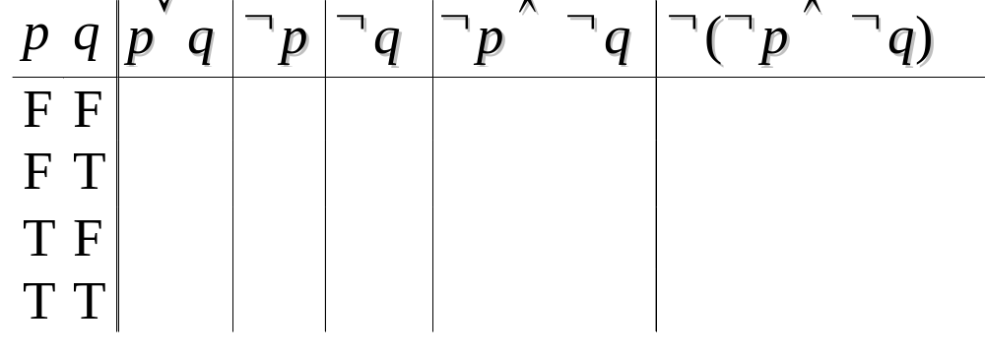
Proving Equivalence via Truth Tables
Topic #1.1 – Propositional Logic: Equivalences
Ex. Prove that p∨q ⇔ ¬(¬p ∧ ¬q).
F
T
T
T
F
T
T
F
F
T
T
F
T
F
T
T
F
F
F
T
26年 11月 8日
© 2001-2004 Michael P. Frank, revised by S. Kang
Notes:
Discrete Math - Module #1 - Logic
26年 11月 8日
(c)2001-2002, Michael P. Frank

Slide 38
Equivalence Laws - Examples
Topic #1.1 – Propositional Logic: Equivalences
Identity: p∧T ⇔ p p∨F ⇔ p
Domination: p∨T ⇔ T p∧F ⇔ F
Idempotent: p∨p ⇔ p p∧p ⇔ p
Double negation: ¬¬p ⇔ p
Commutative: p∨q ⇔ q∨p p∧q ⇔ q∧p
Associative: (p∨q)∨r ⇔ p∨(q∨r)
(p∧q)∧r ⇔ p∧(q∧r)
26年 11月 8日
© 2001-2004 Michael P. Frank, revised by S. Kang
Notes:
Discrete Math - Module #1 - Logic
26年 11月 8日
(c)2001-2002, Michael P. Frank

Slide 39
More Equivalence Laws
Topic #1.1 – Propositional Logic: Equivalences
Distributive: p∨(q∧r) ⇔ (p∨q)∧(p∨r)
p∧(q∨r) ⇔ (p∧q)∨(p∧r)
De Morgan’s Law:
¬(p∧q) ⇔ ¬p ∨ ¬q
¬(p∨q) ⇔ ¬p ∧ ¬q
Trivial tautology/contradiction:
p ∨ ¬p ⇔ T p ∧ ¬p ⇔ F
26年 11月 8日
© 2001-2004 Michael P. Frank, revised by S. Kang
Notes:
Discrete Math - Module #1 - Logic
26年 11月 8日
(c)2001-2002, Michael P. Frank

Slide 40
Defining Operators via Equivalences
Topic #1.1 – Propositional Logic: Equivalences
Using equivalences, we can define operators in terms of other operators.
Exclusive or: p⊕q ⇔ (p∨q)∧¬(p∧q)
p⊕q ⇔ (p∧¬q)∨(q∧¬p)
Implies: p→q ⇔ ¬p ∨ q
Biconditional: p↔q ⇔ (p→q) ∧ (q→p)
p↔q ⇔ ¬(p⊕q)
26年 11月 8日
© 2001-2004 Michael P. Frank, revised by S. Kang
Notes:
Discrete Math - Module #1 - Logic
26年 11月 8日
(c)2001-2002, Michael P. Frank

Slide 41
An Example Problem
Topic #1.1 – Propositional Logic: Equivalences
Check using a symbolic derivation whether
(p ∧ ¬q) → (p ⊕ r) ⇔ ¬p ∨ q ∨ ¬r.
(p ∧ ¬q) → (p ⊕ r) [Expand definition of →]
⇔ ¬(p ∧ ¬q) ∨ (p ⊕ r) [Expand defn. of ⊕]
⇔ ¬(p ∧ ¬q) ∨ ((p ∨ r) ∧ ¬(p ∧ r))
[DeMorgan’s Law]
⇔ (¬p ∨ q) ∨ ((p ∨ r) ∧ ¬(p ∧ r))
cont.
26年 11月 8日
© 2001-2004 Michael P. Frank, revised by S. Kang
Notes:
Discrete Math - Module #1 - Logic
26年 11月 8日
(c)2001-2002, Michael P. Frank

Slide 42
Example Continued...
Topic #1.1 – Propositional Logic: Equivalences
(¬p ∨ q) ∨ ((p ∨ r) ∧ ¬(p ∧ r)) ⇔ [∨ commutes]
⇔ (q ∨ ¬p) ∨ ((p ∨ r) ∧ ¬(p ∧ r)) [∨ associative]
⇔ q ∨ (¬p ∨ ((p ∨ r) ∧ ¬(p ∧ r))) [distrib. ∨ over ∧]
⇔ q ∨ (((¬p ∨ (p ∨ r)) ∧ (¬p ∨ ¬(p ∧ r)))
[assoc.] ⇔ q ∨ (((¬p ∨ p) ∨ r) ∧ (¬p ∨ ¬(p ∧ r)))
[trivial taut.] ⇔ q ∨ ((T ∨ r) ∧ (¬p ∨ ¬(p ∧ r)))
[domination] ⇔ q ∨ (T ∧ (¬p ∨ ¬(p ∧ r)))
[identity] ⇔ q ∨ (¬p ∨ ¬(p ∧ r)) ⇔ cont.
26年 11月 8日
© 2001-2004 Michael P. Frank, revised by S. Kang
Notes:
Discrete Math - Module #1 - Logic
26年 11月 8日
(c)2001-2002, Michael P. Frank

Slide 43
End of Long Example
Topic #1.1 – Propositional Logic: Equivalences
q ∨ (¬p ∨ ¬(p ∧ r))
[DeMorgan’s] ⇔ q ∨ (¬p ∨ (¬p ∨ ¬r))
[Assoc.] ⇔ q ∨ ((¬p ∨ ¬p) ∨ ¬r)
[Idempotent] ⇔ q ∨ (¬p ∨ ¬r)
[Assoc.] ⇔ (q ∨ ¬p) ∨ ¬r
[Commut.] ⇔ ¬p ∨ q ∨ ¬r
Q.E.D. (quod erat demonstrandum)
(Which was to be shown.)
26年 11月 8日
© 2001-2004 Michael P. Frank, revised by S. Kang
Notes:
Discrete Math - Module #1 - Logic
26年 11月 8日
(c)2001-2002, Michael P. Frank

Slide 44
Review: Propositional Logic
(§§1.1-1.2)
Topic #1 – Propositional Logic
Atomic propositions: p, q, r, …
Boolean operators: ¬ ∧ ∨ ⊕ → ↔
Compound propositions: s :≡ (p ∧ ¬q) ∨ r
Equivalences: p∧¬q ⇔ ¬(p → q)
Proving equivalences using:
  Truth tables.
  Symbolic derivations. p ⇔ q ⇔ r …
26年 11月 8日
© 2001-2004 Michael P. Frank, revised by S. Kang
Notes:
Discrete Math - Module #1 - Logic
26年 11月 8日
(c)2001-2002, Michael P. Frank

